Slide 1





A Partnership
Notes:
CS: 2 – 9
JP – 10 – 16
DL: 17 - 25

Slide 2
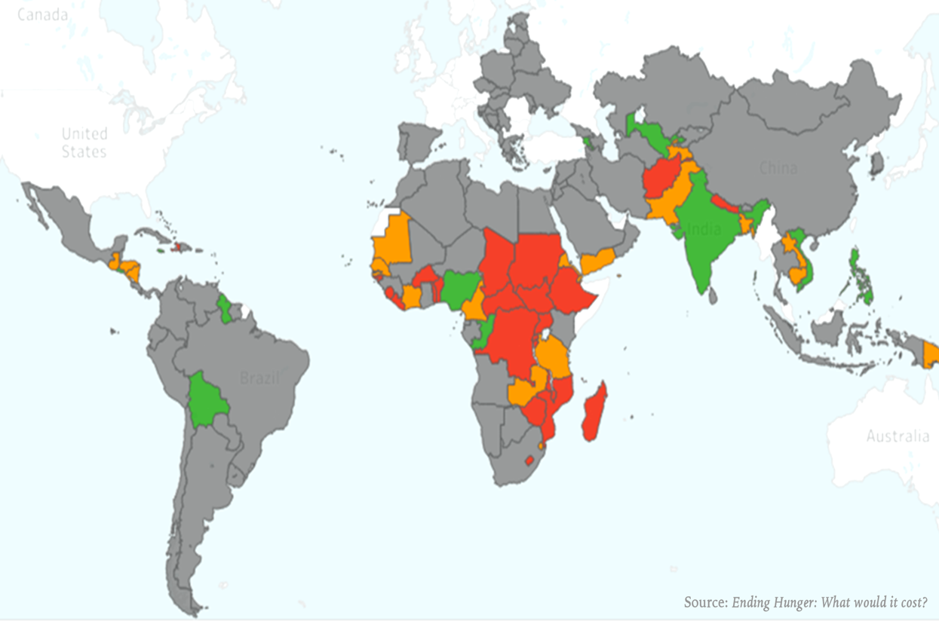
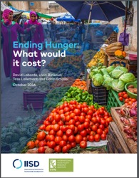
Ending Hunger: What would it cost? [2016]
We are not on track for SDG2
But we can reach it if we
  Have more resources
  Use better interventions
  Realign priorities
Notes:
This leads to our new project
Mobilizing evidences to achieve SDG2 in cost effective way

Slide 3
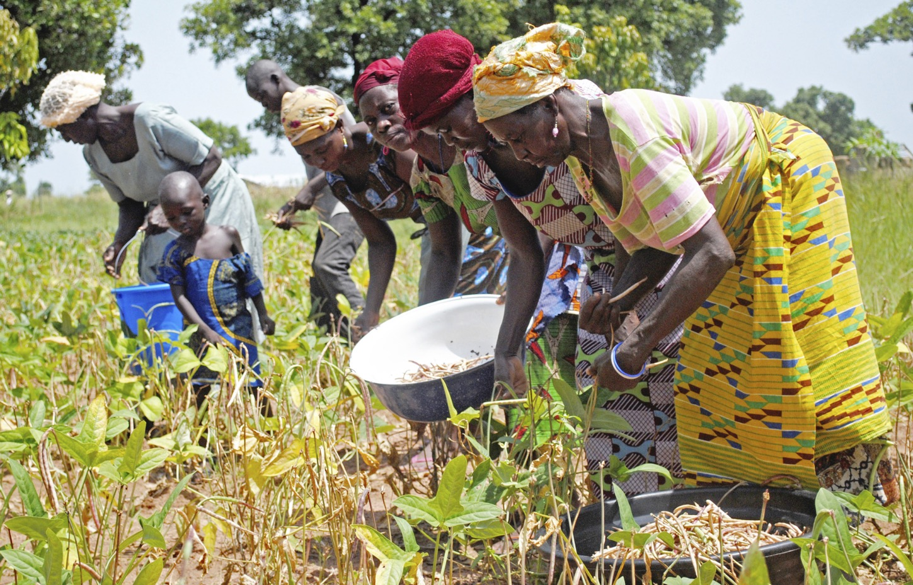
Our mission
To build consensus on the interventions needed to end hunger and transform the lives of the world's poorest farmers—while protecting the environment.

Slide 4
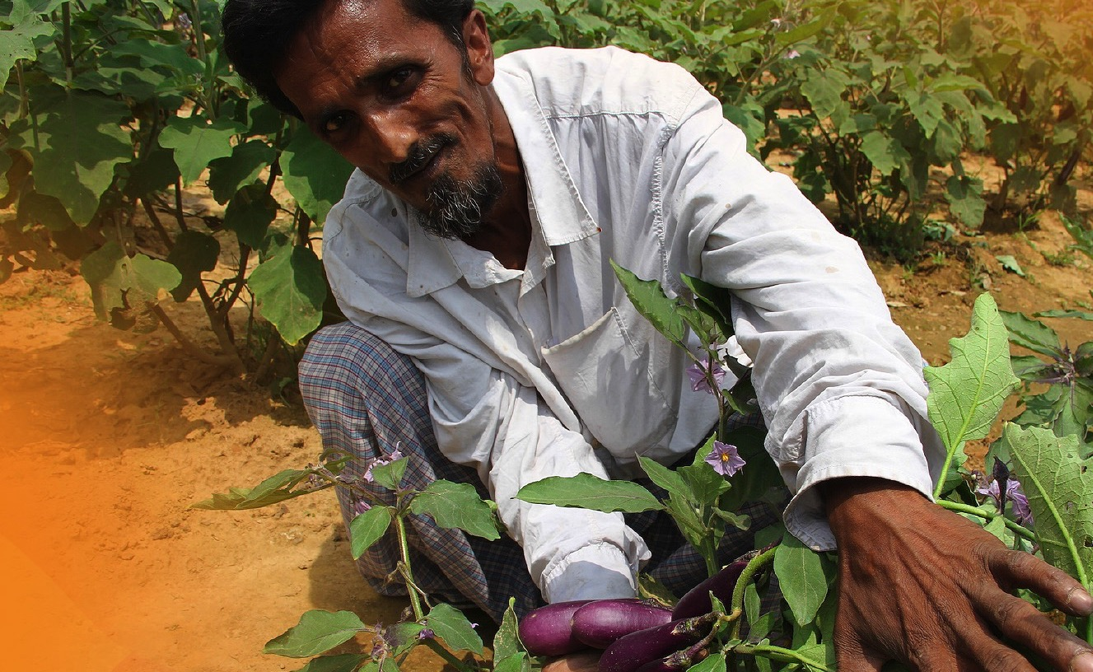

Our strategy
We combine state-of-the-art modelling techniques with expert evidence to support a donor roadmap to achieve SDG 2 (focusing on targets 2.1, 2.3 and 2.4)

Slide 5
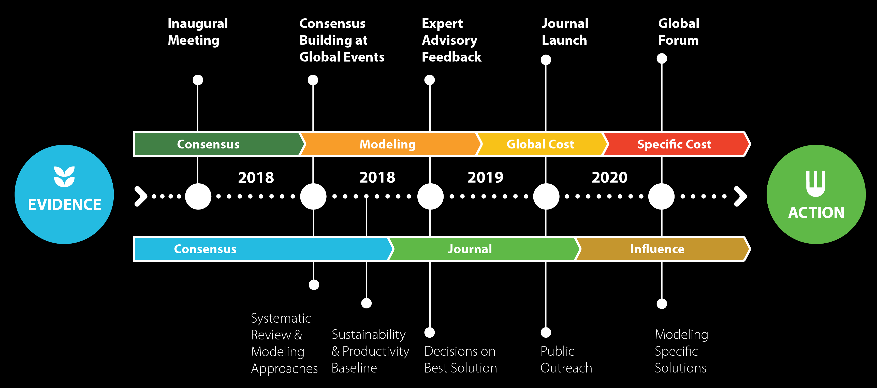
We are here

Slide 6
How do we develop rigorous evidence?

Slide 7
Our framing question
The HLPF reported a dearth of evidence for SDG 2.3 and 2.4 in a review of SDG 2 in 2017.
Ceres2030 conducted a scoping study to evaluate this claim and finds similar results.

Slide 8
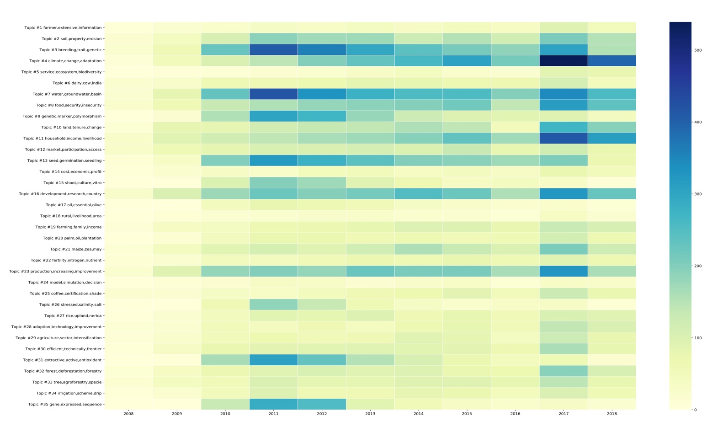
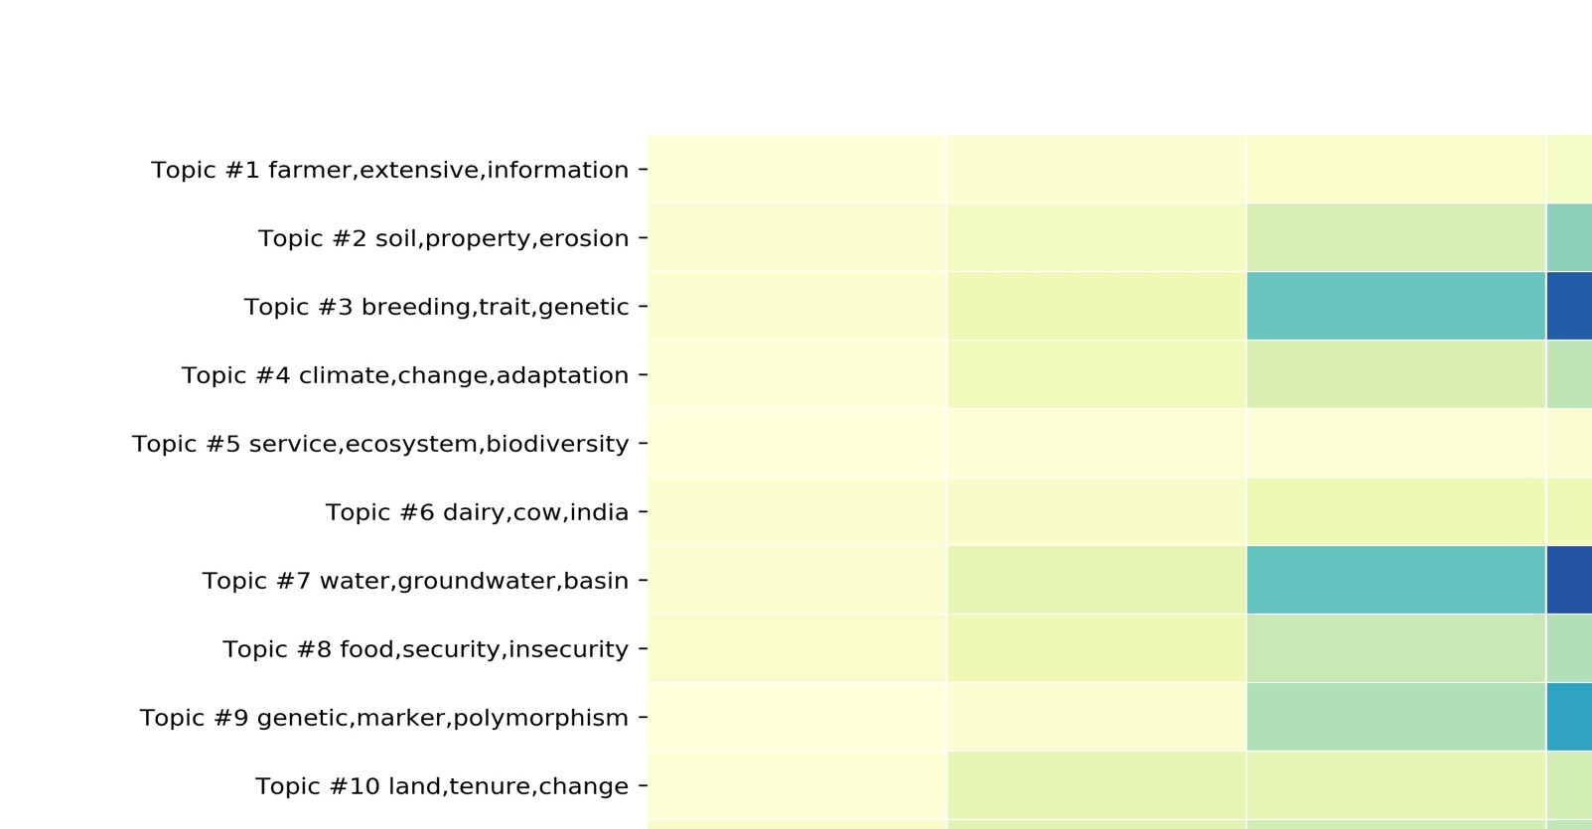
What does the research baseline look like?
Notes:
We use machine learning models to explore the text. Natural language tools bypass the limitations presented by databases and see into the granular conversations science is having. It takes difficult scientific concepts and assigns them to more understandable terms. We assign confidence intervals to quantify relevancy. This presents a much friendly way to assess materials without losing scientific complexity.

Slide 9
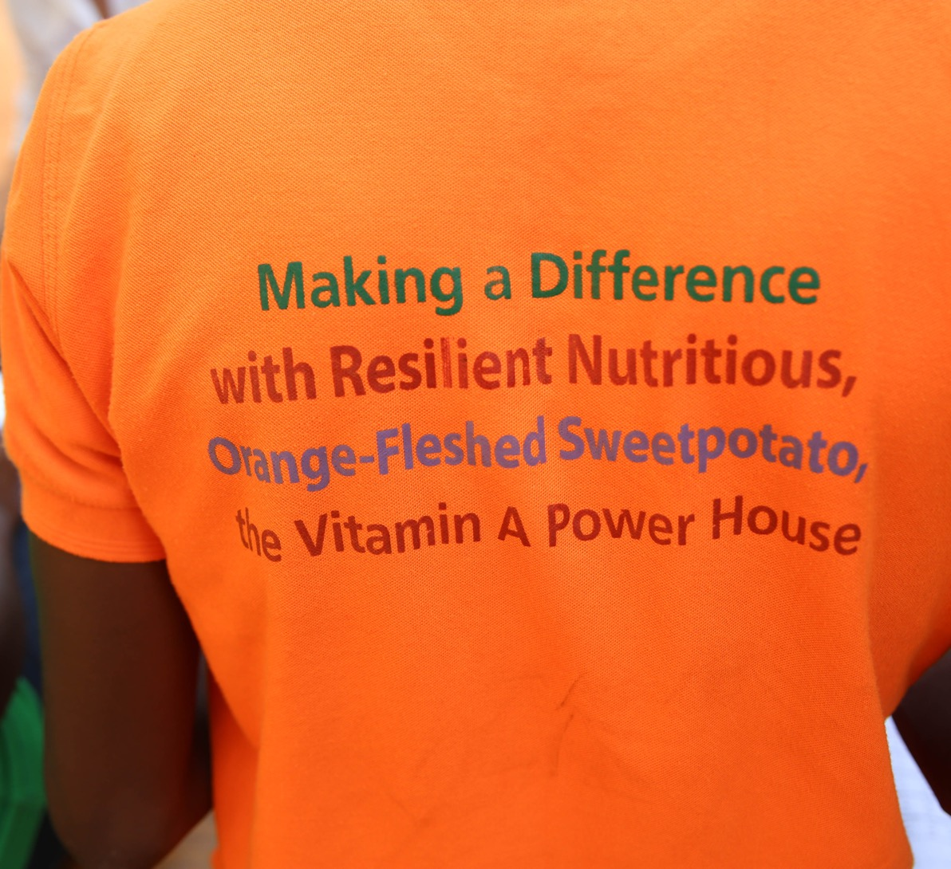
What do we mean by evidence?
Meeting the SDGs requires “better” evidence
Intervention effectiveness information is scattered
Research is abundant
Many scientists are trained to write research, not evidence
Clearly defined standards of evidence can help promote common ground and consensus building

Slide 10
Our work
Nature will publish 7-10 evidence reviews of “best bets” for SDG 2.3 and 2.4
Baseline instruments from the cost models will inform intervention topics
A global advisory board will guide topic and author selection
Tools like risk of bias assessment and protocols help scientists to contribute evidence
Our integrated dashboard combines research across siloes to generate better analytics
We will generate media and policy relevant materials from the findings

Slide 11
Proactive Engagement strategy (2018)
Science
May: Policy and Science (Ithaca)
July: ICAE (Vancouver)
August: AAEA (Washington)
August: SDG2 (Wageningen)
October: Science Policy Forum (South Africa)
November: IFPRI/FAO (Thailand)
Policy
September: UNGA (New York)
September: G20/T20 (Buenos Aires)
October: CFS (Rome)
December: AERC Biannual Conference (Kenya)
Donors
April: SDG2 Roadmap Initiative (Washington D.C)
September: G7 food security working group (Ottawa)
October: SDG2 Roadmap Initiative (Rome)

Slide 12
Journal Advisory Board
Belay Begashaw, Sustainable Development Goals Center for Africa (Rwanda)
Catherine Bertini, Rockefeller Foundation Fellow, Chicago Council (USA)
Joachim von Braun, Bonn University (Germany)
Ronnie Coffman, Cornell University (USA)
Boaz Keizire, Alliance for a Green Revolution in Africa (AGRA) (Kenya)
Segenut Kelemu, International Centre of Insect Physiology and Ecology (ICIPE) (Kenya)
Uma Lele, International Policy Expert (USA/India)
Leslie Lipper, Independent Science and Policy Council (FAO) (Italy)
Lindiwe Majele Sibanda, Farmer and Food Systems Champion
Njuguna Ndung'u, African Economic Research Council (Kenya)
Will Martin, International Food Policy and Research Institute (IFPRI) (USA)
Prabhu Pingali, Cornell University (USA)
Martin Piñeiro, Director CEO Group, Chair, Committee on Agriculture, Argentine Council of International Relations
Ruerd Ruben, Wageningen University
Maximo Torero, World Bank (USA)
Paul Winters, International Fund Agricultural Development (IFAD) (Italy)
Scott Vaughan, International Institute for Sustainable Development (IISD) (Canada)
Li Xiaoyun, China Agricultural University (China)

Slide 13
Potential questions
What is the impact on crop yields and water use when farmers use ICTs to manage irrigation?
What is the mix of interventions that contribute to poverty reduction while improving market access and off-farm employment opportunities?
What is the impact of early warning climate and famine systems on crop loss and economic resilience?

Slide 14
Modeling Framework
Notes:
10 sec

Slide 15
Existing SDG2 Costing
Exercise
52 billion
IMPACT (IFPRI)
265 billion
Achieving Zero Hunger
(FAO, IFAD, WFP)
11 billion
MIRAGRODEP
(IFPRI-IISD)
7 billion
Investment Framework
for Nutrition
(World Bank)
IFPRI Brief: Quantifying the cost and benefits of ending hunger and undernutrition: Examining the differences among alternative approaches
Notes:
DL 30 sec

Slide 16
Existing SDG2 Costing
Exercise
How much would hunger
decrease given investments
to achieve target yield
increases by 2030?
52 billion
IMPACT (IFPRI)
What are the additional transfers and investments needed to end poverty and hunger in all countries by 2030?
265 billion
Achieving Zero Hunger
(FAO, IFAD, WFP)
What is the minimum cost to
end hunger for vulnerable
households in all countries
by 2030?
11 billion
MIRAGRODEP
(IFPRI-IISD)
What is the minimum cost to
meet the World Health
Assembly (WHA) goals on
reducing undernutrition
by 2025?
7 billion
Investment Framework
for Nutrition
(World Bank)
IFPRI Brief: Quantifying the cost and benefits of ending hunger and undernutrition: Examining the differences among alternative approaches
Notes:
DL 30 sec

Slide 17
Ceres2030 Model Overview
QUESTIONS
Targets for SDG 2
2.1 Target
2.3 Targets
2.4 Targets
Notes:
DL 30 sec

Slide 18
Ceres2030 Model Overview
QUESTIONS
Achieve Goals,
Minimize Cost
Targets for SDG 2
2.1 Target
2.3 Targets
2.4 Targets
Notes:
DL 30 sec

Slide 19

Ceres2030 Model Overview
QUESTIONS
OUTPUT
Achieve Goals,
Minimize Cost
Total Cost
to accomplish SDG 2 targets
Optimal Funding Allocation
by kind of intervention
Targets for SDG 2
2.1 Target
2.3 Targets
2.4 Targets
Notes:
DL 30 sec

Slide 20
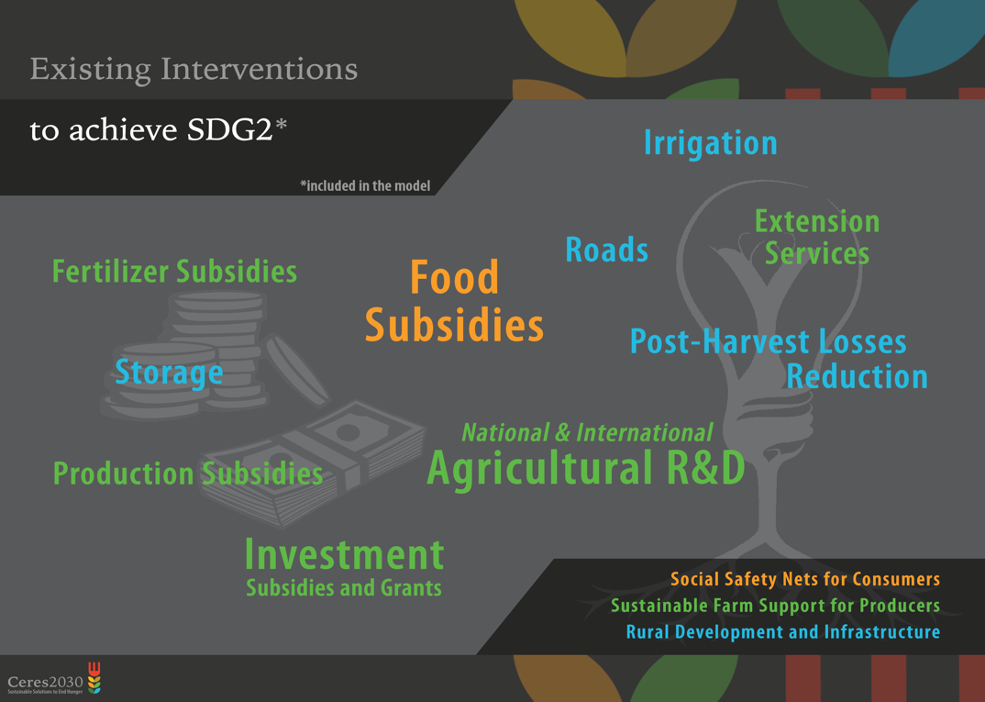



Slide 21
Comprehensive Modelling
Micro Level
Household Variables
food and nutrition security, agricultural productivity, …
Notes:
DL: 1 mn

Slide 22
Comprehensive Modelling
Meso Level
Regional and Sectoral Variables
food prices, wages, water use, …
Micro Level
Micro Level
Household Variables
food and nutrition security, agricultural productivity, …
Notes:
DL: 1 mn

Slide 23
Comprehensive Modelling
Macro Level
International Macroeconomic Variables
International trade linkages, fiscal balance, …
Meso Level
Meso Level
Regional and Sectoral Variables
food prices, wages, water use, …
Micro Level
Micro Level
Micro Level
Household Variables
food and nutrition security, agricultural productivity, …
Notes:
DL: 1 mn

Slide 24
Comprehensive Modelling
Macro Level
Macro Level
International Macroeconomic Variables
International trade linkages, fiscal balance, …
Meso Level
Meso Level
Meso Level
Integrated, multi-level approach
Model: MIRAGRODEP Computable General Equilibrium with household-level data
Regional and Sectoral Variables
food prices, wages, water use, …
Micro Level
Micro Level
Micro Level
Micro Level
Household Variables
food and nutrition security, agricultural productivity, …
Notes:
DL: 1 mn

Slide 25

Selecting Indicators for Targets
Select indicators that reflect our SDG 2 subgoals…
Notes:
DL 20 sec

Slide 26
Selecting Indicators for Targets
Select indicators that reflect our SDG 2 subgoals…
?
…given limited consensus on definitions and data.
Notes:
DL 20 sec

Slide 27




Monitored And Targeted Population
Where do I belong?
The Hungry
I
The Farmer
The Poor
Notes:
DL: 1 mn

Slide 28
Selecting Indicators for Targets
Subgoals
UN-Proposed Indicators
UN Tier
In Model?
SDG 2.1
End Hunger
Prevalence of Undernourishment
1
Yes
Well-defined indicator, directly used in model
Food Insecurity Experience Scale
2
No
Not used, insufficient data
SDG 2.3
Smallholder
Productivity
Production
per Labor Unit
3
Yes
Used, some limitations
Average Income by Sex and Indigenous Status
3
Yes
Used, some limitations
SDG 2.4
Sustainability
% of Agricultural Area that Is Sustainable
3
No
Not defined by UN
Alternative indicators used
Notes:
1mn

Slide 29
Summary of Indicators
Subgoals
Proposed Indicators in Model
Scale
Limits
SDG 2.1
End Hunger
Prevalence of Undernourishment
Household
Only Caloric Hunger
SDG 2.3
Smallholder
Productivity
SDG 2.4
Sustainability
Notes:
DL 30 sec

Slide 30
Summary of Indicators
Subgoals
Proposed Indicators in Model
Scale
Limits
SDG 2.1
End Hunger
Prevalence of Undernourishment
Household
Only Caloric Hunger
SDG 2.3
Smallholder
Productivity
Net Income for smallholder farmers
Household
Strong Overlap with
SDG 1
SDG 2.4
Sustainability
Notes:
DL 30 sec

Slide 31
Summary of Indicators
Subgoals
Proposed Indicators in Model
Scale
Limits
SDG 2.1
End Hunger
Prevalence of Undernourishment
Household
Only Caloric Hunger
SDG 2.3
Smallholder
Productivity
Net Income for smallholder farmers
Household
Strong Overlap with
SDG 1
?
SDG 2.4
Sustainability
Notes:
DL 30 sec

Slide 32
SDG 2.4
?

Slide 33
SDG 2.4
Economic dimension
Model rationality
Water Needs
Monitoring
Social Dimension
No One Left Behind
(2.1, 2.3)
Adaptation Included in 2.1 and 2.3
Mitigation:
GHG Emissions
Land Use
Fertilizer
Use
Energy Use

Slide 34
Summary of Indicators
Subgoals
Proposed Indicators in Model
Scale
Limits
SDG 2.1
End Hunger
Prevalence of Undernourishment
Household
Only Caloric Hunger
SDG 2.3
Smallholder
Productivity
Net Income for smallholder farmers
Household
Strong Overlap with
SDG 1
SDG 2.4
Sustainability
Total GHG emissions in agriculture
Fertilizer Use | Energy Use | Land Use
+ Water Requirements
National
Have to be considered with other indicators
Notes:
DL 30 sec

Slide 35
From Indicators to Quantitative Targets
Subgoals
Proposed Indicators in Model
Target
Prevalence of Undernourishment
SDG 2.1
End Hunger
5%
Notes:
DL 30 sec

Slide 36
From Indicators to Quantitative Targets
Subgoals
Proposed Indicators in Model
Target
Prevalence of Undernourishment
SDG 2.1
End Hunger
5%
SDG 2.3
Smallholder
Productivity
X2
Smallholder productivity
Notes:
DL 30 sec

Slide 37

From Indicators to Quantitative Targets
Subgoals
Proposed Indicators in Model
Target
Prevalence of Undernourishment
SDG 2.1
End Hunger
5%
SDG 2.3
Smallholder
Productivity
X2
Smallholder productivity
SDG 2.4
Sustainability
Total GHG emissions in agriculture
Fertilizer Use | Energy Use | Land Use
+ Water Requirements
NDC
Notes:
DL 30 sec

Slide 38

Thank you

